Slide 1

Algorithm Analysis Design (Externsl PaperSolution)
Submitted by: Submitted To:
Name:Riya Pawar Dr. Shsligram Prajapat Sir
Roll no:(IT-2k20-50)
1Q)Analyze the time complexity of the Quick Sort algorithm in average case and provide a step-by-step explanation of the sorting process
QuickSort is a sorting algorithm based on the Divide and Conquer algorithm that picks an element as a pivot and partitions the given array around the picked pivot by placing the pivot in its correct position in the sorted array.
How does QuickSort work?
The key process in quickSort is a partition(). The target of partitions is to place the pivot (any element can be chosen to be a pivot) at its correct position in the sorted array and put all smaller elements to the left of the pivot, and all greater elements to the right of the pivot.
This partition is done recursively which finally sorts the array. See the below image for a better understanding.

Slide 2
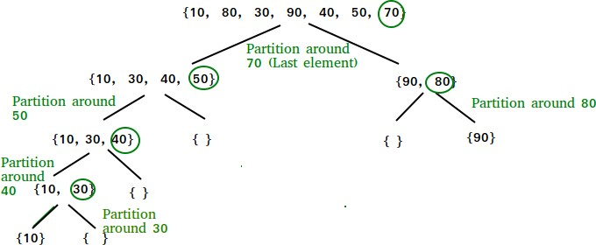
Program to implement QuickSort:
Follow the below steps to implement the algorithm:
Create a recursive function (say quicksort()) to implement the quicksort.
Partition the range to be sorted (initially the range is from 0 to N-1) and return the correct position of the pivot (say pi).
Select the rightmost value of the range to be the pivot.
Iterate from the left and compare the element with the pivot and perform the partition as shown above.
Return the correct position of the pivot.
Recursively call the quicksort for the left and the right part of the pi.
Below is the implementation of the Quicksort:
// C code to implement quicksort
#include <stdio.h>

Slide 3
// Function to swap two elements void swap(int* a, int* b)
{
int t = *a;
*a = *b;
*b = t;
}
// Partition the array using the last element as the pivot
int partition(int arr[], int low, int high)
{
// Choosing the pivot int pivot = arr[high];
// Index of smaller element and indicates
// the right position of pivot found so far int i = (low - 1);

Slide 4
for (int j = low; j <= high - 1; j++) {
// If current element is smaller than the
pivot
if (arr[j] < pivot) {
// Increment index of smaller element i++;
swap(&arr[i], &arr[j]);
}
}
swap(&arr[i + 1], &arr[high]); return (i + 1);
}
// The main function that implements QuickSort
// arr[] --> Array to be sorted,

Slide 5
// low --> Starting index,
// high --> Ending index
void quickSort(int arr[], int low, int high)
{
if (low < high) {
// pi is partitioning index, arr[p]
// is now at right place
int pi = partition(arr, low, high);
// Separately sort elements before
// partition and after partition quickSort(arr, low, pi - 1); quickSort(arr, pi + 1, high);
}
}
// Driver code

Slide 6
int main()
{
int arr[] = { 10, 7, 8, 9, 1, 5 };
int N = sizeof(arr) / sizeof(arr[0]);
// Function call quickSort(arr, 0, N - 1); printf("Sorted array: \n"); for (int i = 0; i < N; i++)
printf("%d ", arr[i]); return 0;
}
Average Case Time Complexity of Quick Sort
O(Nlog(N))
the overall average case for the quick sort is this which we will get by taking average of all complexities
Explanation
lets T(n) be total time taken
then for average we will consider random element as pivot lets index i be pivot

Slide 7
then time complexity will be T(n) = T(i) + T(n-i)
T(n) = 1/n *[\sum_{i=1}^{n-1} T(i)] + 1/n*[\sum_{i=1}^{n-1} T(n-i)]
As [\sum_{i=1}^{n-1} T(i)] and [\sum_{i=1}^{n-1} T(n-i)] equal likely functions
therefore
T(n) = 2/n*[\sum_{i=1}^{n-1} T(i)]
multiply both side by n
n*T(n) = 2*[\sum_{i=1}^{n-1} T(i)] ............(1)
put n = n-1
(n-1)*T(n-1) = 2*[\sum_{i=1}^{n-2} T(i)] ............(2)
substract 1 and 2 then we will get
n*T(n) - (n-1)*T(n-1) = 2*T(n-1) + c*n^2 + c*(n-1)^2 n*T(n) = T(n-1)[2+n-1] + 2*c*n - c
n*T(n) = T(n-1)*(n+1) + 2*c*n [removed c as it was constant]
divide both side by n*(n+1),
T(n)/(n+1) = T(n-1)/n + 2*c/(n+1) .............(3)
put n = n-1,
T(n-1)/n = T(n-2)/(n-1) + 2*c/n ............(4)
put n = n-2,
T(n-2)/n = T(n-3)/(n-2) + 2*c/(n-1) ............(5)
by putting 4 in 3 and then 3 in 2 we will get
T(n)/(n+1) = T(n-2)/(n-1) + 2*c/(n-1) + 2*c/n + 2*c/(n+1)

Slide 8
also we can find equation for T(n-2) by putting n = n-2 in (3)
at last we will get
T(n)/(n+1) = T(1)/2 + 2*c * [1/(n-1) + 1/n + 1/(n+1) + .....]
T(n)/(n+1) = T(1)/2 + 2*c*log(n) + C T(n) = 2*c*log(n) * (n+1)
now by removing constants, T(n) = log(n)*(n+1) therefore,
T(n) = O(n*log(n))
Q 2) Critically evaluate Strassen’s matrix multiplication algorithm and compare its time complexiy with traditional matric multiplication method.
Strassen’s Matrix Multiplication is the divide and conquer approach to solve the matrix multiplication problems. The usual matrix multiplication method multiplies each row with each column to achieve the product matrix. The time complexity taken by this approach is O(n³), since it takes two loops to multiply. Strassen’s method was introduced to reduce the time complexity from O(n³) to O(n^{log 7}).
Naïve Method

Slide 9
First, we will discuss naïve method and its complexity. Here, we are calculating Z=𝑿X × Y. Using Naïve method, two matrices (X and Y) can be multiplied if the order of these matrices are p × q and q × r and the resultant matrix will be of order p × r. The following pseudocode describes the naïve multiplication −
Algorithm: Matrix-Multiplication (X, Y, Z)
for i = 1 to p do for j = 1 to r do
Z[i,j] := 0
for k = 1 to q do
Z[i,j] := Z[i,j] + X[i,k] × Y[k,j]
Complexity
Here, we assume that integer operations take O(1) time. There are three for loops in this algorithm and one is nested in other. Hence, the algorithm takes O(n³) time to execute.
Strassen’s Matrix Multiplication Algorithm
In this context, using Strassen’s Matrix multiplication algorithm, the time consumption can be improved a little bit.
Strassen’s Matrix multiplication can be performed only on square matrices where n is a power of 2. Order of both of the matrices are n × n.
Divide X, Y and Z into four (n/2)×(n/2) matrices as represented below –
Strassen’s 7 calls are as follows: a * (f - h)
(a + b) * h
(c + d) * e

Slide 10
d * (g - e)
(a + d) * (e + h)
(b - d) * (g + h)
(a - c) * (e + f)
Our new matrix C’s new quadrants matrix C = |p5+p4-p2+p6 p1+p2 |
| p3+p4 p1+p5-p3-p7|

Slide 11
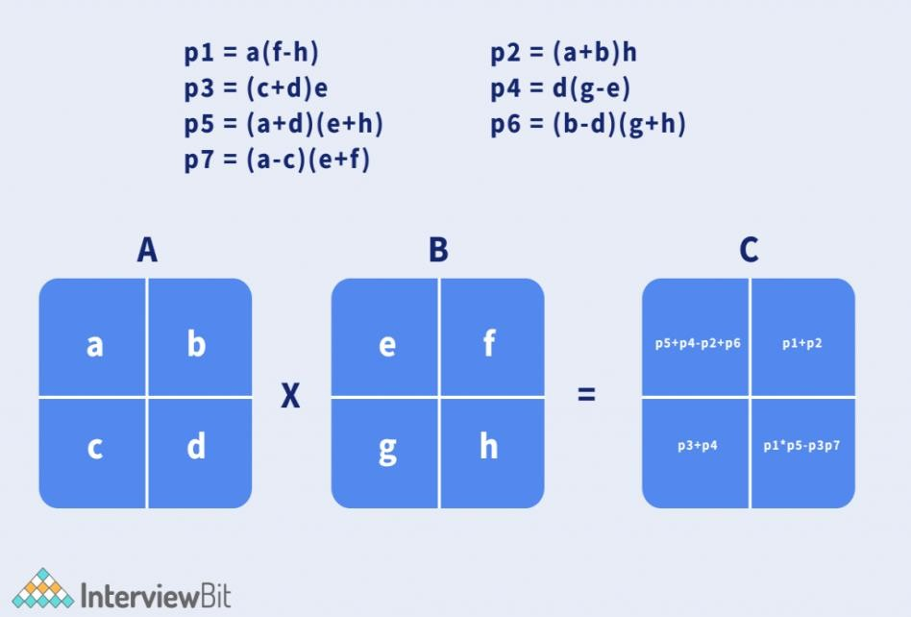
Strassen’s Submatrix
p5+p4-p2+p6 = (a+d)*(e+h) + d*(g-e) - (a+b)*h + (b-d)*(g+h)
= (ae+de+ah+dh) + (dg-de) - (ah+bh) + (bg-dg+bh-dh)
= ae+bg
p1+p2 = a*(f-h) + (a+b)*h
= (af-ah) + (ah+bh)

Slide 12
= af+bh
p3+p4 = (c+d)*e + d*(g-e)
= (ce+de) + (dg-de)
= ce+dg
p1+p5-p3-p7 = a*(f-h) + (a+d)*(e+h) - (c+d)*e - (a-c)*(e+f)
= (af-ah) + (ae+de+ah+dh) -(ce+de) - (ae-ce+af-cf)
= cf+dh
The time complexity using the Master Theorem.
T(n) = 7T(n/2) + O(n^2) = O(n^log(7)) runtime. Approximately O(n^2.8074) which is better than O(n^3)

Slide 13
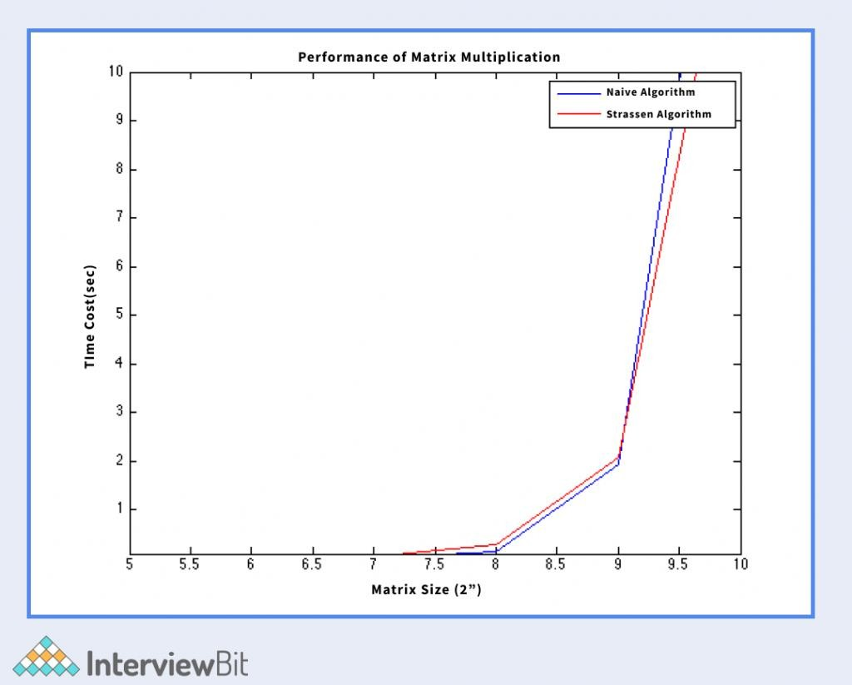

Slide 14
Pseudocode of Strassen’s multiplication
Divide matrix A and matrix B in 4 sub-matrices of size N/2 x N/2 as shown in the above diagram.
Calculate the 7 matrix multiplications recursively.
Compute the submatrices of C.
Combine these submatricies into our new matrix C
Complexity
Worst case time complexity: Θ(n^2.8074)
Best case time complexity: Θ(1)
Space complexity: Θ(logn)
Q3a)Evaluate Prim’s algorithm for finding the minimal spanning tree ,and provide real world scenario where it can be applied.
Introduction to Prim’s Algorithm
Prim’s algorithm is used to find the Minimum Spanning Tree for a given graph. But, what is a Minimum Spanning Tree, or MST for short? A minimum spanning tree T(V’, E’) is a subset of graph G(V, E) with the same number of vertices as of graph G (V’ = V) and edges equal to the number of vertices of graph G minus one (E’ = |V| - 1). Prim's approach identifies the subset of edges that includes every vertex in the graph, and allows the sum of the edge weights to be minimized.
Prim’s algorithm starts with a single node and works its way through several adjacent nodes, exploring all of the connected

Slide 15
edges along the way. Edges with the minimum weights that do not cause cycles in the graph get selected for t inclusion in the MST structure. Hence, we can say that Prim’s algorithm takes a locally optimum decision in order to find the globally optimal solution. That is why it is also known as a Greedy Algorithm.
How to Create MST Using Prim’s Algorithm
Let’s first look into the steps involved in Prim’s Algorithm to generate a minimum spanning tree:
Step 1: Determine the arbitrary starting vertex.
Step 2: Keep repeating steps 3 and 4 until the fringe vertices (vertices not included in MST)remain.
Step 3: Select an edge connecting the tree vertex and fringe vertex having the minimum weight.
Step 4: Add the chosen edge to MST if it doesn’t form any closed cycle.
Step 5: Exit
Using the steps mentioned above, we are supposed to generate a minimum spanning tree structure. Let’s have a look at an example to understand this process better.
Graph G(V, E) given below contains 9 vertices and 12 edges. We are supposed to create a minimum spanning tree T(V’, E’) for G(V, E) such that the number of vertices in T will be 9 and edges will be 8 (9-1).

Slide 16
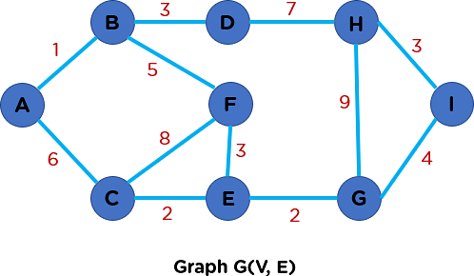
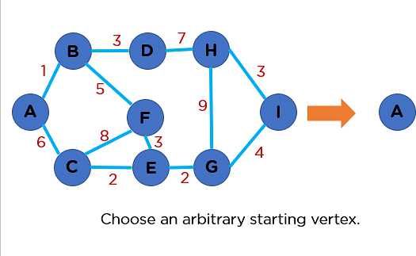
Primarily, to begin with the creation of MST, you will choose an arbitrary starting vertex. Let’s say node A is your starting vertex. This means it will be included first in your tree structure.

Slide 17
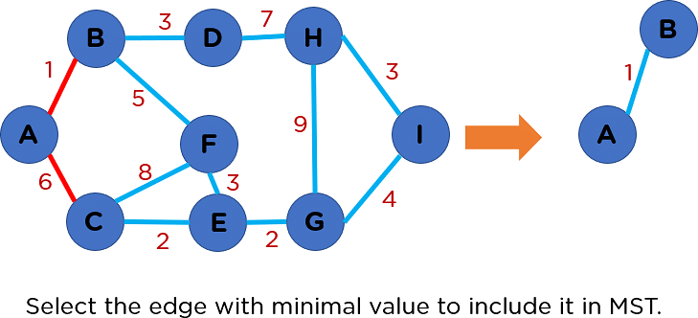
After the inclusion of node A, you will look into the connected edges going outward from node A and you will pick the one with a minimum edge weight to include it in your T(V’, E’) structure.
Now, you have reached node B. From node B, there are two possible edges out of which edge BD has the least edge weight value. So, you will include it in your MST.
From node D, you only have one edge. So, you will include it in your MST. Further, you have node H, for which you have two incident edges. Out of those two edges, edge HI has the least cost, so you will include it in MST structure.

Slide 18
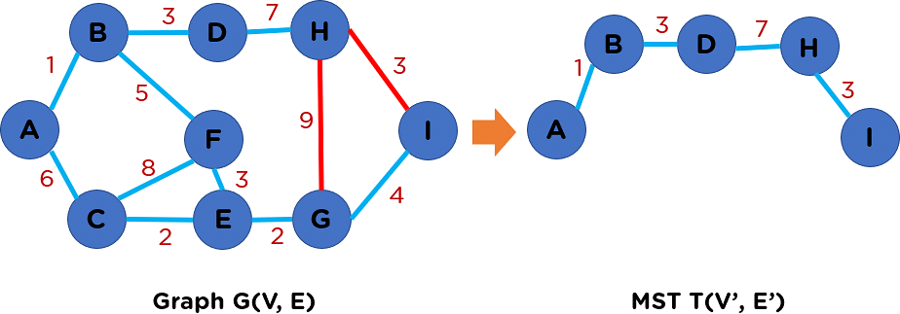
Similarly, the inclusion of nodes G and E will happen in MST.

Slide 19
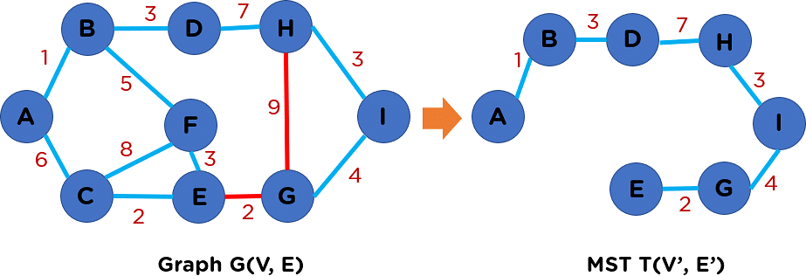
After that, nodes E and C will get included. Now, from node C, you have two incident edges. Edge CA has the tiniest edge weight. But its inclusion will create a cycle in a tree structure, which you cannot allow. Thus, we will discard edge CA as shown in the image below.

Slide 20
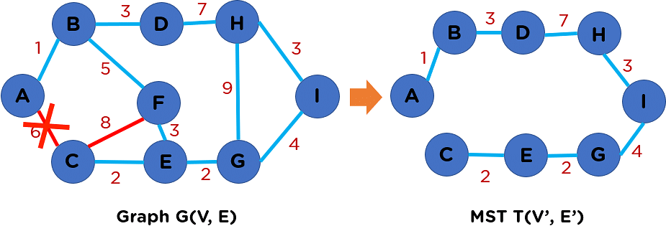
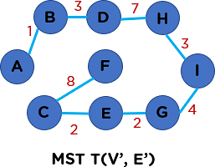
And we will include edge CF in this minimum spanning tree structure.
The summation of all the edge weights in MST T(V’, E’) is equal to 30, which is the least possible edge weight for any possible spanning tree structure for this particular graph.
Moving ahead, we will learn about the coding implementation

Slide 21
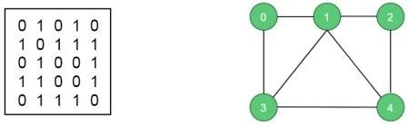
Real-world scenario: It can be applied to determine the most cost-
effective way to connect a network of cities with different distances between them. For example, in a telecommunications network, Prim's algorithm can be used to find the minimum-cost layout of connections between cities to minimize the total cost of establishing the network infrastructure.
3Qb) Analyse Hamiltonian cycles and provide an example of how they can be used in real life application.
In an undirected graph, the Hamiltonian path is a path, that visits each vertex exactly once, and the Hamiltonian cycle or circuit is a Hamiltonian path, that there is an edge from the last vertex to the first vertex.
In this problem, we will try to determine whether a graph contains a Hamiltonian cycle or not. And when a Hamiltonian cycle is present, also print the cycle.
Input and Output Input:
The adjacency matrix of a graph G(V, E).
Output:

Slide 22
The algorithm finds the Hamiltonian path of the given graph. For this case it is (0, 1, 2, 4, 3, 0). This graph has some other Hamiltonian paths.
If one graph has no Hamiltonian path, the algorithm should return false.
Algorithm
isValid(v, k)
Input − Vertex v and position k.
Output − Checks whether placing v in the position k is valid or not.
Begin
if there is no edge between node(k-1) to v, then return false
if v is already taken, then
return false
return true; //otherwise it is valid End
cycleFound(node k) Input − node of the graph.
Output − True when there is a Hamiltonian Cycle, otherwise false.
Begin
if all nodes are included, then
if there is an edge between nodes k and 0, then return true
else
return false;

Slide 23
for all vertex v except starting point, do
if isValid(v, k), then //when v is a valid edge add v into the path
if cycleFound(k+1) is true, then return true
otherwise remove v from the path done
return false End
Example
#include<iostream> #define NODE 5 using namespace std;
int graph[NODE][NODE] = {
{0, 1, 0, 1, 0},
{1, 0, 1, 1, 1},
{0, 1, 0, 0, 1},
{1, 1, 0, 0, 1},
{0, 1, 1, 1, 0},
};
/* int graph[NODE][NODE] = {
{0, 1, 0, 1, 0},
{1, 0, 1, 1, 1},
{0, 1, 0, 0, 1},

Slide 24
{1, 1, 0, 0, 0},
{0, 1, 1, 0, 0},
}; */
int path[NODE]; void displayCycle() {
cout<<"Cycle: ";
for (int i = 0; i < NODE; i++) cout << path[i] << " ";
cout << path[0] << endl;
//print the first vertex again
}
bool isValid(int v, int k) {
if (graph [path[k-1]][v] == 0) return false;
//if there is no edge
for (int i = 0; i < k; i++) if (path[i] == v)
return false; return true;
//if vertex is already taken, skip that
}
bool cycleFound(int k) { if (k == NODE) {
//when all vertices are in the path

Slide 25
if (graph[path[k-1]][ path[0] ] == 1 ) return true;
else
return false;
}
for (int v = 1; v < NODE; v++) { //for all vertices except starting point
if (isValid(v,k)) { //if possible to add v in the path path[k] = v;
if (cycleFound (k+1) == true) return true;
path[k] = -1; //when k vertex will not in the solution
}
}
return false;
}
bool hamiltonianCycle() {
for (int i = 0; i < NODE; i++) path[i] = -1;
path[0] = 0; //first vertex as 0
if ( cycleFound(1) == false ) {
cout << "Solution does not exist"<<endl; return false;
}

Slide 26
displayCycle(); return true;
}
int main() { hamiltonianCycle();
}
Example application: In logistics and transportation planning, finding a Hamiltonian cycle can help optimize the order of visiting
multiple locations, such as delivery routes for a courier service.
The cycle ensures that each location is visited exactly once,
minimizing the travel distance and time
Q 4)Apply analytical persepectives to develop a greedy algorithm for sequencing unit time jobs with deadlines and profits .Discuss the advantage and limitation of this approach.
In this problem, the objective is to maximize the total profit by
sequencing unit time jobs within their deadlines.
Advantages: Greedy algorithms provide a simple and efficient solution for this problem. They are easy to implement and often yield a reasonably good solution. They have a time complexity of O(n log n) if the jobs are sorted based on their deadlines.
Limitations: Greedy algorithms may not always find the optimal solution. In some cases, they can result in suboptimal solutions if

Slide 27
the greedy choice leads to a locally optimal solution that doesn't guarantee the global optimum.
 |  |  |  |  | In this problem, the objective is to maximize the total profit by sequencing unit time jobs within their deadlines. Advantages: Greedy algorithms provide a simple and efficient solution for this problem. They are easy to implement and often yield a reasonably good solution. They have a time complexity of O(n log n) if the jobs are sorted based on their deadlines. Limitations: Greedy algorithms may not always find the optimal solution. In some cases, they can result in suboptimal solutions if the greedy choice leads to a locally optimal solution that doesn't guarantee the global optimum.
 |  |  | In the Job Sequencing with Deadlines problem, the objective is to
 |  |  | find a sequence or the order of the jobs, which is completed within their deadlines and gives maximum profit, given the condition that we are using a single processor OS (operating system) which is capable of performing one job at a time.
Job scheduling algorithm is applied to schedule the jobs on a single processor to maximize the profits.
The greedy approach of the job scheduling algorithm states that, “Given ‘n’ number of jobs with a starting time and ending time, they need to be scheduled in such a way that maximum profit is received within the maximum deadline”.

Slide 28
Job Scheduling Algorithm
Set of jobs with deadlines and profits are taken as an input with the job scheduling algorithm and scheduled subset of jobs with maximum profit are obtained as the final output.
Algorithm
Find the maximum deadline value from the input set of jobs.
Once, the deadline is decided, arrange the jobs in descending order of their profits.
Selects the jobs with highest profits, their time periods not
exceeding the maximum deadline.
The selected set of jobs are the output. Examples
Consider the following tasks with their deadlines and profits. Schedule the tasks in such a way that they produce maximum profit after being executed −
S. No. | 1 | 2 | 3 | 4 | 5
Jobs | J1 | J2 | J3 | J4 | J5
Deadlines | 2 | 2 | 1 | 3 | 4
Profits | 20 | 60 | 40 | 100 | 80
Step 1
Find the maximum deadline value, dm, from the deadlines given. dm = 4.
Step 2
Arrange the jobs in descending order of their profits.

Slide 29
S. No. | 1 | 2 | 3 | 4 | 5
Jobs | J4 | J5 | J2 | J3 | J1
Deadlines | 3 | 4 | 2 | 1 | 2
Profits | 100 | 80 | 60 | 40 | 20
The maximum deadline, dm, is 4. Therefore, all the tasks must end before 4.
Choose the job with highest profit, J4. It takes up 3 parts of the maximum deadline.
Therefore, the next job must have the time period 1. Total Profit = 100.
Step 3
The next job with highest profit is J5. But the time taken by J5 is 4, which exceeds the deadline by 3. Therefore, it cannot be added to the output set.
Step 4
The next job with highest profit is J2. The time taken by J5 is 2, which also exceeds the deadline by 1. Therefore, it cannot be added to the output set.
Step 5
The next job with higher profit is J3. The time taken by J3 is 1, which does not exceed the given deadline. Therefore, J3 is added to the output set.
Total Profit: 100 + 40 = 140
Step 6

Slide 30
Since, the maximum deadline is met, the algorithm comes to an end. The output set of jobs scheduled within the deadline are {J4, J3} with the maximum profit of 140.
5 Q) Derive the time complexity of the iterative and recursive versions of the fibbonacci function to compare their efficiency in each case.
Fibonacci Series in C Using Recursion
In recursion, The function calls itself until the base condition is met. Here, the function fib() makes a call to itself.
Here is the code to find the Fibonacci series in C using a recursive function.
Code:
#include<stdio.h>
int fib(int n) { if (n == 1)
return 0; //First digit in the series is 0
else if (n == 2)
return 1; //Second digit in the series is 1
else
return (fib(n - 1) + fib(n - 2)); //Sum of previous two numbers in the series gives the next number in the series
}

Slide 31
int main() { int n = 5; int i; printf("The fibonacci series is :\n"); for (i = 1; i <= n; i++) { printf("%d ", fib(i)); } }
Output:
The fibonacci series is : 0 1 1 2 3
Explanation: In the above code, we created a function named fib(), which has an integer as the parameter and return value data type. In the main function, we iterate over a loop from 1 to n times, and at each iteration, called the fib() function. In fib() function, if the parameter passed is 0 or 1, we will return the same value; otherwise, we will return the sum of recursive calls with parameter values one and two less than our current parameter, which is fib(i-1)+fib(i-2). Time and Space Complexity of Recursive Method
The time complexity of the above code is T(2^N), i.e., exponential.
The Space complexity of the above code is O(N) for a
recursive series.
Fibonacci Series in C Without Recursion

Slide 32
We discussed how to implement the Fibonacci series using recursion. The Fibonacci series in C can be implemented without using recursion also. Let us look at the different ways of implementing the Fibonacci series without using recursion.
Using dynamic programming
In dynamic programming, We will store all the previously calculated values of the Fibonacci numbers in an array. We know that the array is zero-indexed. Therefore the Fibonacci numbers are stored in the n-1 array index. For example, the 2nd Fibonacci number is stored in the 1st index of the array.
Code
#include<stdio.h>
int fib(int n) { int arr[5]; int i;
arr[0] = 0; // First term is zero arr[1] = 1; // Second term is one for (i = 2; i <= n; i++) {
arr[i] = arr[i - 1] + arr[i - 2]; //Calculating the sum of previous two fibonacci numbers
}
for (i = 0; i <= n - 1; i++) { printf("%d ", arr[i]);
}
}
int main() { int n = 5;
printf("The Fibonacci series is : \n");
fib(n);

Slide 33
return 0; }
Output
The Fibonacci series is : 0 1 1 2 3
Explanation In the above code, In the main() function, We called the fib() function with n as a parameter. The value of n is initialized to 5. In the fib() function, We create an array of size n, in our case, an array of size 5 to hold the Fibonacci numbers. The first and second element in the array is initialized to 0 and 1, respectively. Later we used for loop to find the other elements of the array i.e the Fibonacci numbers using the formula arr[i] = arr[i-1] + arr[i- 2]. Later we will print all the elements in the array. Time Complexity and Space Complexity of Dynamic Programming
The time complexity of the above code is T(N), i.e., linear.
We have to find the sum of two terms, and it is repeated n times depending on the value of n.
The space complexity of the above code is O(N).
8Q a)Write a non-deterministic search and sort algorithm.
A non-deterministic search and sort algorithm is not a well-defined concept. Search and sort algorithms are typically deterministic, meaning they follow a specific set of steps and produce the same output for a given input.

Slide 34
In computer science, non-determinism typically refers to non- deterministic algorithms used in the context of non-deterministic Turing machines or computational models like nondeterministic finite automata (NFA). These models are theoretical constructs used to analyze the computational complexity of problems.
If you have a specific problem or scenario in mind, please provide more details, and I can help you with an appropriate search or sort algorithm.
8 Q b)analyse and compare the class P,NP,NP-hard and NP- complete problems and provide examples of each .Discuss their significance in computer science and their potential real-world applications.
P (Polynomial Time):
Class of problems that can be solved by an algorithm in polynomial time.
Examples: Sorting algorithms (e.g., Merge Sort, Quick Sort),
finding the shortest path in a graph (e.g., Dijkstra's algorithm).
Significance: P problems have efficient algorithms that can be solved in a reasonable amount of time as the input size increases. They are fundamental to many practical applications in computer science, such as data processing, optimization, and graph algorithms.
NP (Nondeterministic Polynomial Time):
Class of decision problems for which a potential solution can be verified in polynomial time.
Examples: Boolean satisfiability problem (SAT), traveling
salesperson problem (TSP), knapsack problem.

Slide 35
Significance: NP problems represent a wide range of important computational challenges. Although finding a solution is generally harder than verifying it, NP problems frequently arise in real-world scenarios. They are crucial for optimization, planning, scheduling, and various other decision-making tasks.
NP-hard (Nondeterministic Polynomial Time-hard):
Class of problems that are at least as hard as the hardest problems in NP.
Examples: Hamiltonian cycle problem, bin packing problem,
vertex cover problem.
Significance: NP-hard problems are some of the most challenging computational problems. They do not necessarily belong to NP but are computationally as difficult as the hardest problems in NP. Solving NP-hard problems efficiently would have far-reaching implications and lead to breakthroughs in various fields, including operations research, cryptography, and algorithm design.
NP-complete (Nondeterministic Polynomial Time-complete):
Class of problems that are both in NP and NP-hard.
Examples: Boolean satisfiability problem (SAT), traveling salesperson problem (TSP), knapsack problem.
Significance: NP-complete problems are the most difficult
problems in NP. They are both verifiable in polynomial time and at least as hard as any problem in NP. Solving any NP-complete problem efficiently would imply that all problems in NP can be solved efficiently. The importance of NP-complete problems lies in their theoretical implications, indicating the inherent difficulty of solving certain types of problems and forming the basis of complexity theory.
Real-world applications:

Slide 36
P problems: Sorting algorithms are used extensively in data processing, database systems, and information retrieval. Shortest path algorithms find applications in network routing, GPS navigation, and logistics planning.
NP problems: SAT is used in automated reasoning, circuit design, and software testing. TSP has applications in logistics, tour planning, and chip manufacturing. Knapsack problem is relevant in resource allocation, portfolio optimization, and project scheduling.
NP-hard problems: Hamiltonian cycle problem has applications in DNA sequencing, electronic circuit testing, and network optimization. Bin packing problem is relevant in resource allocation, bin packing in warehouses, and memory management. Vertex cover problem is used in network design, facility location, and social network analysis.
NP-complete problems: The theoretical significance of NP- complete problems is profound. Their real-world applications span various domains, including optimization, scheduling, planning, cryptography, artificial intelligence, and bioinformatics. While efficient algorithms for NP-complete problems are not known, approximation algorithms and heuristics are often employed in practice to obtain near-optimal solutions.
6 Q)Explain chained matrix multiplication with a suitable example and discuss its practical applications.
Chained matrix multiplication, also known as matrix chain multiplication, is a method to multiply multiple matrices together efficiently by determining the optimal order of multiplication. The goal is to minimize the number of scalar multiplications required.
Let's consider an example where we have three matrices: A with dimensions 10x20, B with dimensions 20x30, and C with dimensions 30x40. To multiply these matrices together, we have two possible parenthesizations:

Slide 37
(AB)C: Multiply A and B first, resulting in a temporary matrix of dimensions 10x30. Then multiply this temporary matrix with C,
resulting in the final matrix of dimensions 10x40.
A(BC): Multiply B and C first, resulting in a temporary matrix of dimensions 20x40. Then multiply A with this temporary matrix, resulting in the final matrix of dimensions 10x40.
The order of multiplication affects the number of scalar multiplications required. By applying dynamic programming, the optimal order can be determined.
Practical applications of chained matrix multiplication include:
Computer Graphics: Chained matrix multiplication is extensively used in computer graphics for transformations, such as scaling, rotation, translation, and projection. These operations involve multiplying multiple transformation matrices together, and the order of multiplication affects the final result.
Optimization Problems: Many optimization problems involve matrix operations. Chained matrix multiplication plays a crucial role in solving these problems efficiently. Examples include linear programming, dynamic programming, and numerical optimization.
Data Analysis: Chained matrix multiplication is utilized in various data analysis techniques, such as principal component analysis (PCA), singular value decomposition (SVD), and factor analysis. These techniques involve matrix manipulations and require efficient matrix multiplication to handle large datasets.
Signal Processing: In digital signal processing applications, matrices are often used to represent signals and perform operations like filtering, transformation, and compression. Chained matrix multiplication helps optimize these operations and reduce computational complexity.
Overall, chained matrix multiplication is essential in numerous fields where matrix operations are involved. Its efficiency and

Slide 38
optimal order determination contribute to improved performance and resource utilization in various computational tasks.

